Slide 1

6885 Lecture 8 Column Oriented Databases
Sam Madden

Slide 2
Column-Oriented DBs Outline
Query Processing
Compression
Why can’t a commercial row store do this?
What about inserts / loading?
Notes:
Reorg – other features first? Or skip some?

Slide 3


Query Processing Example
SELECT avg(price)
FROM tickstore
WHERE symbol = ‘GM’
AND date = ‘1/17/2007’
1970’s Style Row Store
AVG
price
Complete tuples
SELECT
date=’1/17/07’
Complete tuples
SELECT
sym = ‘GM’
Complete tuples
Disk
GM | 30.77 | 1,000 | NYSE | 1/17/2007
GM | 30.77 | 10,000 | NYSE | 1/17/2007
GM | 30.78 | 12,500 | NYSE | 1/17/2007
AAPL | 93.24 | 9,000 | NQDS | 1/17/2007
Notes:
Disco picture/hippie joke

Slide 4

Query Processing Example
Basic Column Store
“Early Materialization”
SELECT avg(price)
FROM tickstore
WHERE symbol = ‘GM’
AND date = ‘1/17/2007’
Complete tuples
AVG
price
Complete tuples
Row-oriented plan
SELECT
date=’1/17/07’
Complete tuples
Construct Tuples
SELECT
sym = ‘GM’
GM | 30.77 | 1/17/07
Disk
GM
GM
GM
AAPL
30.77
30.77
30.78
93.24
1,000
10,000
12,500
9,000
1/17/2007
1/17/2007
1/17/2007
1/17/2007
Fields from same tuple at same index (position) in each column file
NYSE
NYSE
NYSE
NQDS

Slide 5
Query Processing Example
AVG
Much less data flowing through memory
C-Store
“Late Materialization”
Prices
Position Lookup
Position Bitmap
(1,1,1,0)
AND
Position Bitmap
(1,1,1,0)
Position Bitmap
(1,1,1,1)
Pos.SELECT
sym = ‘GM’
Pos.SELECT
date=’1/17/07’
Disk
GM
GM
GM
AAPL
30.77
30.77
30.78
93.24
1,000
10,000
12,500
9,000
NYSE
NYSE
NYSE
NQDS
1/17/2007
1/17/2007
1/17/2007
1/17/2007
See Abadi et al
ICDE 07
Notes:
Reread IQ papers on bitmap indexes and index ANDing

Slide 6
Column-Oriented DBs Outline
Query Processing
Compression
Why can’t a commercial row store do this?
What about inserts / loading?

Slide 7
Operating on Compressed Data
AVG
Only possible with late materialization!
Prices
Position Lookup
Position Bitmap
(3x1,1x0)
AND
Position Bitmap
(3x1,1x0)
Position Bitmap
(4x1)
Compression Aware
Pos.SELECT
sym = ‘GM’
Pos.SELECT
date=’1/17/07’
Disk
3xGM
1xAPPL
30.77
+0
+.01
+62.47
1,000
10,000
12,500
9,000
NYSE
NYSE
NYSE
NQDS
4x1/17/2007

Slide 8
Direct Operation Optimizations
Compressed data used directly for position lookup
RLE, Dictionary, Bitmap
Direct Aggregation and GROUP BY on compressed blocks
RLE, Dictionary
Join runs of compressed blocks
RLE, Dictionary
Min/max directly extracted from sorted data

Slide 9
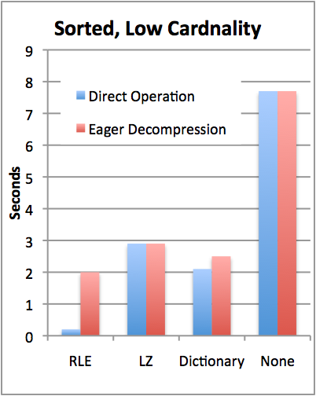
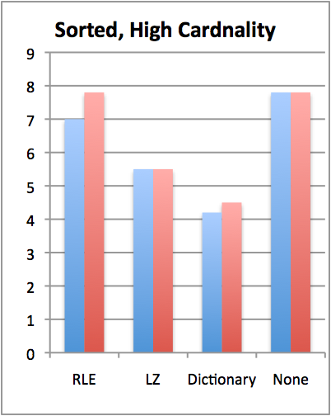

TPC-H Compression Performance
Y | X
1 | A
1 | C
1 | D
2 | B
2 | C
3 | A
Query: SELECT colY, SUM(colX)
FROM lineItem GROUP BY colY
TPC-H Scale 10 (60M records)
Sorted on colY, then colX
colY uncompressed, cardinality varies
Notes:
Consider redesigning

Slide 10
Replication & Recovery
Multiple projections can also support recovery
Store enough projections for “k-safety”
Write-ahead log not required
Replication needed for disaster recovery anyway
Recovering node queries rest of system for data it needs
Rebuilds missing objects from other nodes
Another benefit of multiple sort orders
B₂
A₂
C₂
B₁
B₃
A₃
C₃
B₁
A₁
A₁
C₁
C₁
A1 | A2 | A3
A₃
A₃
B₃
B₃
C₃
B1 | B2 | B3
C₃
A₂
B₂
C₂
A₁
B₁
C₁
C1 | C2 | C3
Lau & Madden, VLDB 2006.

Slide 11
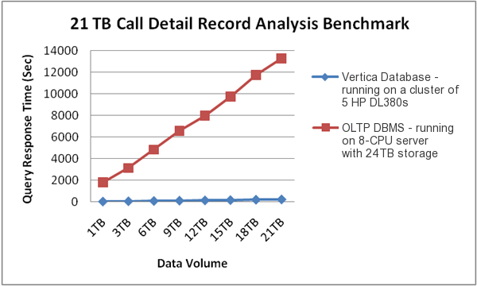
Commercial Benchmark
Vertica Performance:
Avg query time: 3m 41s
Database size: 2.1 TB
vs
Existing Solution:
Avg query time: 30 m
Database Size: 20 TB
(on more expensive hardware)
Customer benchmark
Mobile communications company
20 TB of Call Detail Records
On a 5-node cluster, each with:
2x4-core CPUs, 8GB RAM, 7x146 GB HDDs

Slide 12
Bottom Line
SSBM (Star Schema Benchmark -- O’Neil et al ICDE 08)
Data warehousing benchmark based on TPC-H
Scale 100 (60 M row table)
Average across 12 queries
Row store is a commercial DB, tuned by professional DBA vs C-Store
Commercial System Does Not Benefit From Vertical Partitioning
Time (s)
Notes:
Row store partitions on date

Slide 13
Write Performance
Trickle load: Very Fast Inserts
Tuple Mover
Asynchronous Data
Movement
Batched
Amortizes seeks
Amortizes recompression
Enables continuous load
Queries read from both WOS and ROS
Notes:
Writes performance was a surprise

Slide 14
When to Rewrite ROS Objects?
Store multiple ROS objects, instead of just one
Each of which must be scanned to answer a query
Tuple mover writes new objects
Avoids rewriting whole ROS on merge
Periodically merge ROS objects to limit number of distinct objects that must be scanned (like Big Table)
Older objects
Tuple Mover
WOS
ROS

Slide 15
Summary
C-Store is a “next gen” column-oriented databases
Key New Ideas:
Late materialization
Compression & direct operation
Fast load via “write optimized store”
Row-stores do a poor job of emulation
Need better support for compression, late materialization
Need support for narrow tuples, efficient merge joins
C-Store: http://db.csail.mit.edu/cstore
15
Notes:
Should be at 30 minutes here.

